Slide 1

Chapter 5 How to develop servlets
UNIVERSITY OF SCIENCE AND EDUCATION
The University of Da Nang

Slide 2
Objectives
Applied
Code and test servlets that require the features presented in this chapter.
Use the web.xml file or an annotation to map a servlet to a URL pattern.
Provide for server-side data validation in your applications.
Use the web.xml file to set initialization parameters. Use servlets to get the parameters.
Use the web.xml file to implement custom error handling.
Write debugging data for a servlet to either the console or a log file.
UNIVERSITY OF SCIENCE AND EDUCATION
The University of Da Nang

Slide 3
Objectives (continued)
Applied
Describe servlets and servlet mapping, and their use of request and response objects.
Describe how parameters are passed to a servlet with the HTTP GET method.
List three reasons for using the HTTP POST method instead of the HTTP GET method.
Describe how the ServletContext object is used to get the path for a file. Describe the use of the init, doGet, doPost, and destroy methods in a servlet.
Explain why you should never use instance variables in servlets.
Describe the use of debugging data written to the console or log file.
UNIVERSITY OF SCIENCE AND EDUCATION
The University of Da Nang

Slide 4
A servlet that returns HTML
UNIVERSITY OF SCIENCE AND EDUCATION
The University of Da Nang

Slide 5
A servlet that returns HTML (continued)
UNIVERSITY OF SCIENCE AND EDUCATION
The University of Da Nang

Slide 6
Servlet concepts
The doGet method processes all HTTP requests that use the GET method.
The doPost method processes all HTTP requests that use the POST method.
The doGet and doPost methods both accept (1) the HttpServletRequest object, or the request object, and (2) the HttpServletResponse object, or the response object.
UNIVERSITY OF SCIENCE AND EDUCATION
The University of Da Nang

Slide 7
XML tags that add servlet mapping to web.xml
UNIVERSITY OF SCIENCE AND EDUCATION
The University of Da Nang

Slide 8
XML elements for working with servlet mapping
UNIVERSITY OF SCIENCE AND EDUCATION
The University of Da Nang

Slide 9
Some URL pattern examples
UNIVERSITY OF SCIENCE AND EDUCATION
The University of Da Nang

Slide 10
An annotation that maps a servlet to a URL
UNIVERSITY OF SCIENCE AND EDUCATION
The University of Da Nang

Slide 11
How to use servlet annotations
UNIVERSITY OF SCIENCE AND EDUCATION
The University of Da Nang

Slide 12
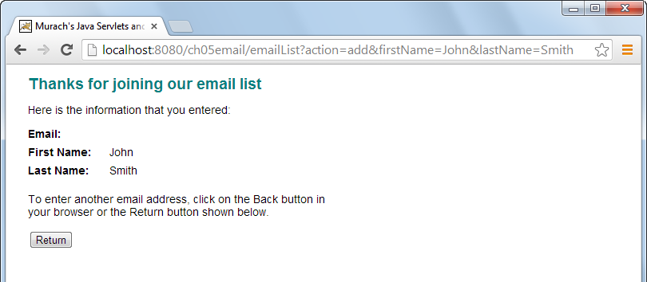
An HTTP request that uses the GET method
UNIVERSITY OF SCIENCE AND EDUCATION
The University of Da Nang

Slide 13
How to append parameters to a URL
UNIVERSITY OF SCIENCE AND EDUCATION
The University of Da Nang

Slide 14
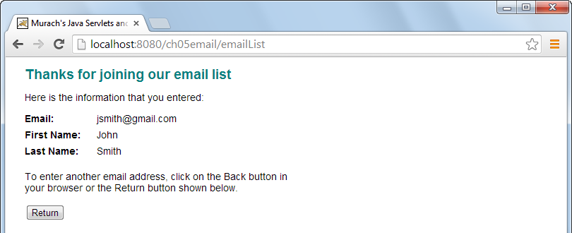
A URL requested with the HTTP POST method
UNIVERSITY OF SCIENCE AND EDUCATION
The University of Da Nang

Slide 15
A Form tag that use the POST method
UNIVERSITY OF SCIENCE AND EDUCATION
The University of Da Nang

Slide 16
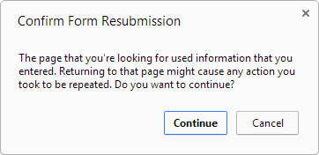
A typical browser dialog that’s displayed if the user tries to refresh a post
UNIVERSITY OF SCIENCE AND EDUCATION
The University of Da Nang

Slide 17
Two methods of the HttpServletRequest object
UNIVERSITY OF SCIENCE AND EDUCATION
The University of Da Nang

Slide 18
Servlet code that gets text from a textbox
UNIVERSITY OF SCIENCE AND EDUCATION
The University of Da Nang

Slide 19
A method of the GenericServlet class
UNIVERSITY OF SCIENCE AND EDUCATION
The University of Da Nang

Slide 20
Code that gets the absolute path for a file
UNIVERSITY OF SCIENCE AND EDUCATION
The University of Da Nang

Slide 21
How to work with the ServletContext object
Because servlets inherit the GenericServlet class, the getServletContext method is available to all servlets.
You can use the ServletContext object to read global initialization parameters, to work with global variables, and to write data to log files.
UNIVERSITY OF SCIENCE AND EDUCATION
The University of Da Nang

Slide 22
Two methods of the HttpServletRequest object
UNIVERSITY OF SCIENCE AND EDUCATION
The University of Da Nang

Slide 23
How to set a request attribute
UNIVERSITY OF SCIENCE AND EDUCATION
The University of Da Nang

Slide 24
A method of the ServletContext object
UNIVERSITY OF SCIENCE AND EDUCATION
The University of Da Nang

Slide 25
How to forward the request to an HTML page
UNIVERSITY OF SCIENCE AND EDUCATION
The University of Da Nang

Slide 26
A method of the HttpServletResponse class
UNIVERSITY OF SCIENCE AND EDUCATION
The University of Da Nang

Slide 27
How to redirect a response…
UNIVERSITY OF SCIENCE AND EDUCATION
The University of Da Nang

Slide 28
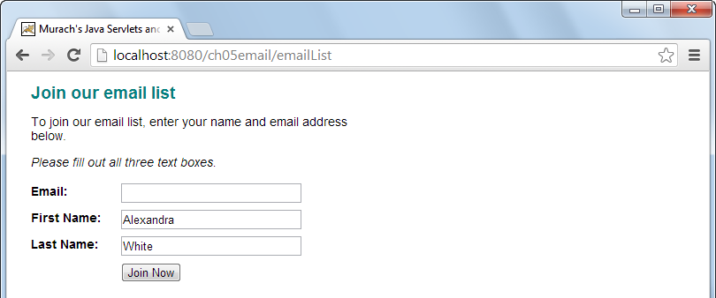
The JSP displayed when an entry isn’t made
UNIVERSITY OF SCIENCE AND EDUCATION
The University of Da Nang

Slide 29
The code for the JSP
UNIVERSITY OF SCIENCE AND EDUCATION
The University of Da Nang

Slide 30
The code for the JSP
UNIVERSITY OF SCIENCE AND EDUCATION
The University of Da Nang

Slide 31
A doPost method that validates data
UNIVERSITY OF SCIENCE AND EDUCATION
The University of Da Nang

Slide 32
A doPost method that validates data (continued)
UNIVERSITY OF SCIENCE AND EDUCATION
The University of Da Nang

Slide 33
A complete web.xml file
UNIVERSITY OF SCIENCE AND EDUCATION
The University of Da Nang

Slide 34
A complete web.xml file
UNIVERSITY OF SCIENCE AND EDUCATION
The University of Da Nang

Slide 35
Concepts about the web.xml file
The web.xml file is stored in the WEB-INF directory. When Tomcat starts, it reads the web.xml file.
If elements in the web.xml aren’t nested correctly, Tomcat displays an error message when it reads the web.xml file.
After you modify the web.xml file, redeploy the application so the changes take effect. Or, restart Tomcat.
UNIVERSITY OF SCIENCE AND EDUCATION
The University of Da Nang

Slide 36
Initialization parameters in a web.xml file
UNIVERSITY OF SCIENCE AND EDUCATION
The University of Da Nang

Slide 37
XML elements for initialization parameters
UNIVERSITY OF SCIENCE AND EDUCATION
The University of Da Nang

Slide 38
An annotation that sets initialization parameters for a servlet
UNIVERSITY OF SCIENCE AND EDUCATION
The University of Da Nang

Slide 39
Initialization parameters
To create an initialization parameter available to all servlets (called a context initialization parameter), code the param-name and param-value elements within the context-param element.
To create an initialization parameter available to a specific servlet (called a servlet initialization parameter), code the param-name and param-value elements within the init-param element. But first, identify the servlet by coding the servlet, servlet-name, and servlet-class elements.
UNIVERSITY OF SCIENCE AND EDUCATION
The University of Da Nang

Slide 40
Two methods of the GenericServlet class
UNIVERSITY OF SCIENCE AND EDUCATION
The University of Da Nang

Slide 41
Code that gets an initialization parameter that’s…
UNIVERSITY OF SCIENCE AND EDUCATION
The University of Da Nang

Slide 42
XML elements for working with error handling
UNIVERSITY OF SCIENCE AND EDUCATION
The University of Da Nang

Slide 43
How to provide error-handling for an HTTP 404 status code
UNIVERSITY OF SCIENCE AND EDUCATION
The University of Da Nang

Slide 44
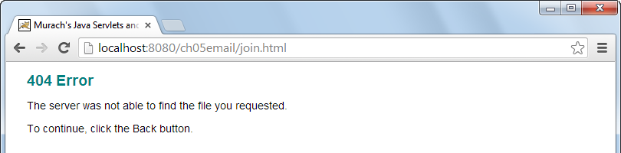
The JSP page for the 404 error
UNIVERSITY OF SCIENCE AND EDUCATION
The University of Da Nang

Slide 45
How to provide error-handling for all Java exceptions
UNIVERSITY OF SCIENCE AND EDUCATION
The University of Da Nang

Slide 46
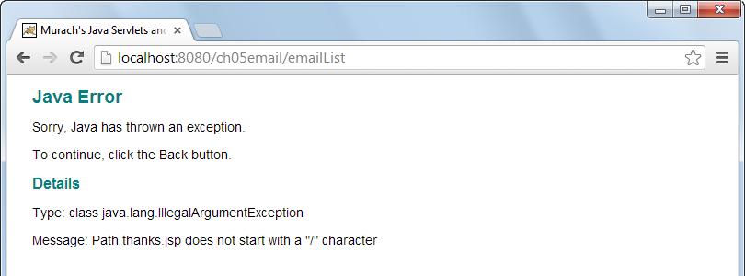
The JSP when a Java exception is thrown
UNIVERSITY OF SCIENCE AND EDUCATION
The University of Da Nang

Slide 47
Five common methods of a servlet
UNIVERSITY OF SCIENCE AND EDUCATION
The University of Da Nang

Slide 48
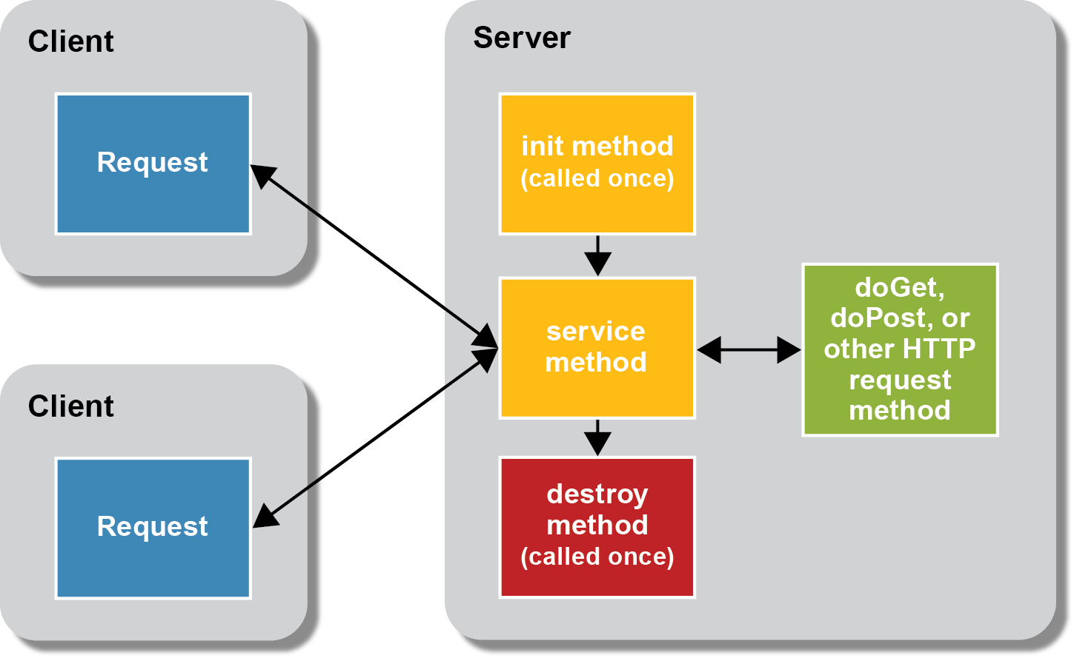
The lifecycle of a servlet
Note
It’s generally considered a bad practice to override the service method. Instead, you should override a method like doGet or doPost to handle a specific type of HTTP request. Init method chỉ khởi tạo 1 lần khi run application
UNIVERSITY OF SCIENCE AND EDUCATION
The University of Da Nang

Slide 49
A servlet with an instance variable
UNIVERSITY OF SCIENCE AND EDUCATION
The University of Da Nang

Slide 50
A servlet with an instance variable (continued)
UNIVERSITY OF SCIENCE AND EDUCATION
The University of Da Nang

Slide 51
Why you shouldn’t use instance variables in servlets
An instance variable of a servlet belongs to the one instance of the servlet and is shared by any threads that request the servlet.
Instance variables are not thread-safe. Two threads may conflict when they try to read, modify, and update the same instance variable at the same time, which can result in lost updates or other problems.
UNIVERSITY OF SCIENCE AND EDUCATION
The University of Da Nang

Slide 52
Common servlet problems
UNIVERSITY OF SCIENCE AND EDUCATION
The University of Da Nang

Slide 53
Code that prints debugging data to the console
UNIVERSITY OF SCIENCE AND EDUCATION
The University of Da Nang

Slide 54
How to print debugging data to the console
Use the println method of the System.out or System.err objects to display debugging messages on the console for the servlet engine.
When you use debugging messages to display variable values, include servlet name and variable name so messages are easy to interpret.
NetBeans displays a tab for the Tomcat console within its Output window.
UNIVERSITY OF SCIENCE AND EDUCATION
The University of Da Nang

Slide 55
Two methods of the HttpServlet class
UNIVERSITY OF SCIENCE AND EDUCATION
The University of Da Nang

Slide 56
Servlet code that prints a variable to a log file
UNIVERSITY OF SCIENCE AND EDUCATION
The University of Da Nang

Slide 57
Servlet code that prints a stack trace to a log file
UNIVERSITY OF SCIENCE AND EDUCATION
The University of Da Nang

Slide 58
The location of a typical Tomcat log file
UNIVERSITY OF SCIENCE AND EDUCATION
The University of Da Nang

Slide 59
How to print debugging data to a log file
Use the log methods of the HttpServlet class to write debugging data to web server’s log file.
Stack trace is the chain of method calls for any statement that calls a method.
Data that’s written by log methods varies from one server to another. The name and location of the log files may also vary from one server to another.
NetBeans displays a tab for the server log within its Output window.
UNIVERSITY OF SCIENCE AND EDUCATION
The University of Da Nang

Slide 60
Reference
Murach’s Java Serverlets and JSP (3st edition)
UNIVERSITY OF SCIENCE AND EDUCATION
The University of Da Nang

